Slide 1

Neural Substrates of Attention and Awareness
Dan Birman
Gardner Lab
Lightning Talks – 2015-04-23

Slide 2
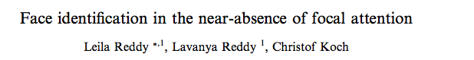

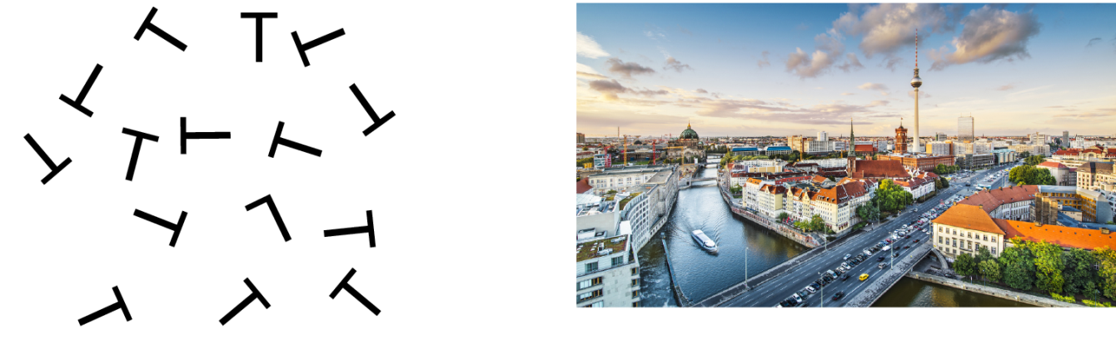

Slide 3
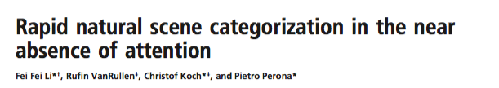

Slide 4


Slide 5


Slide 7
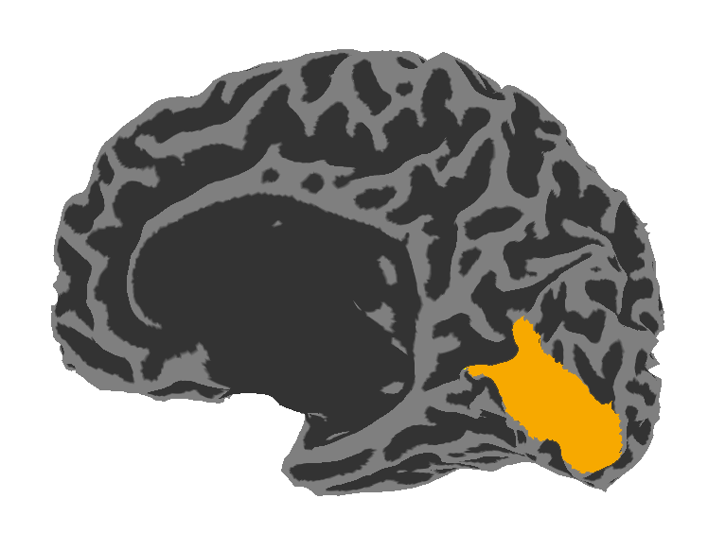

Slide 8
Visual Area V1:
Sensitive to Contrast

Slide 9
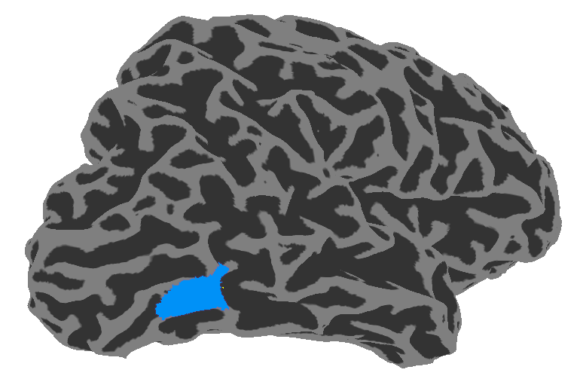
Visual Area V1:
Sensitive to Contrast
Visual Area hMT:
Sensitive to Motion Coherence

Slide 10
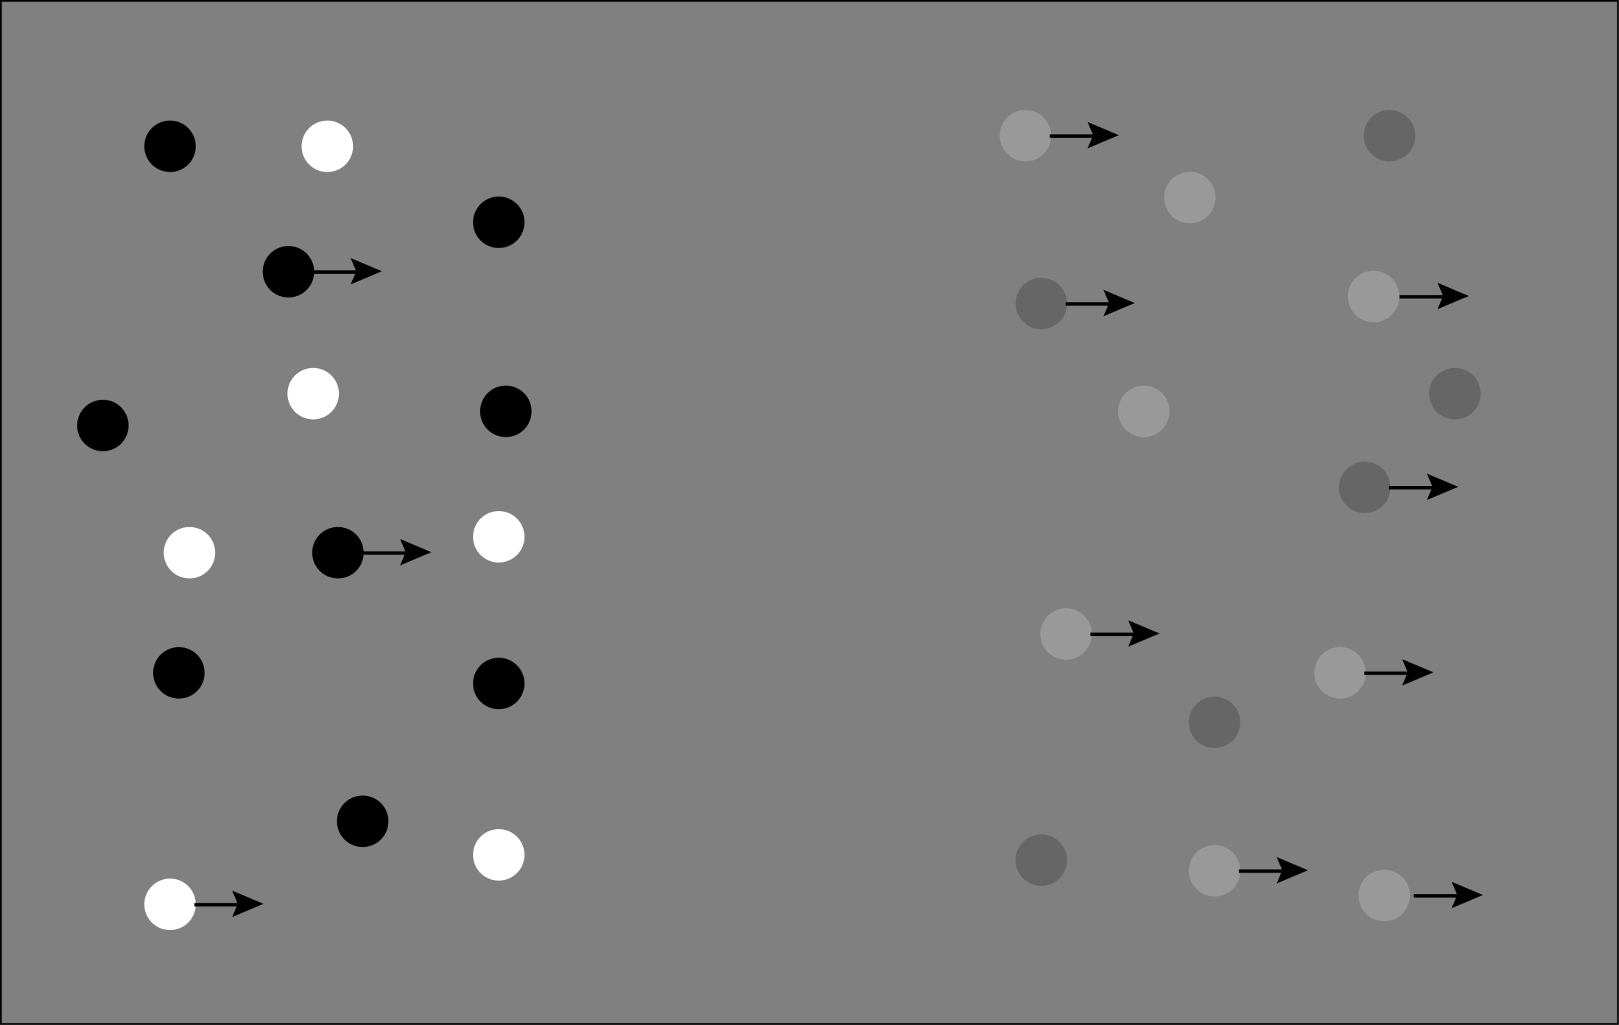

Slide 11
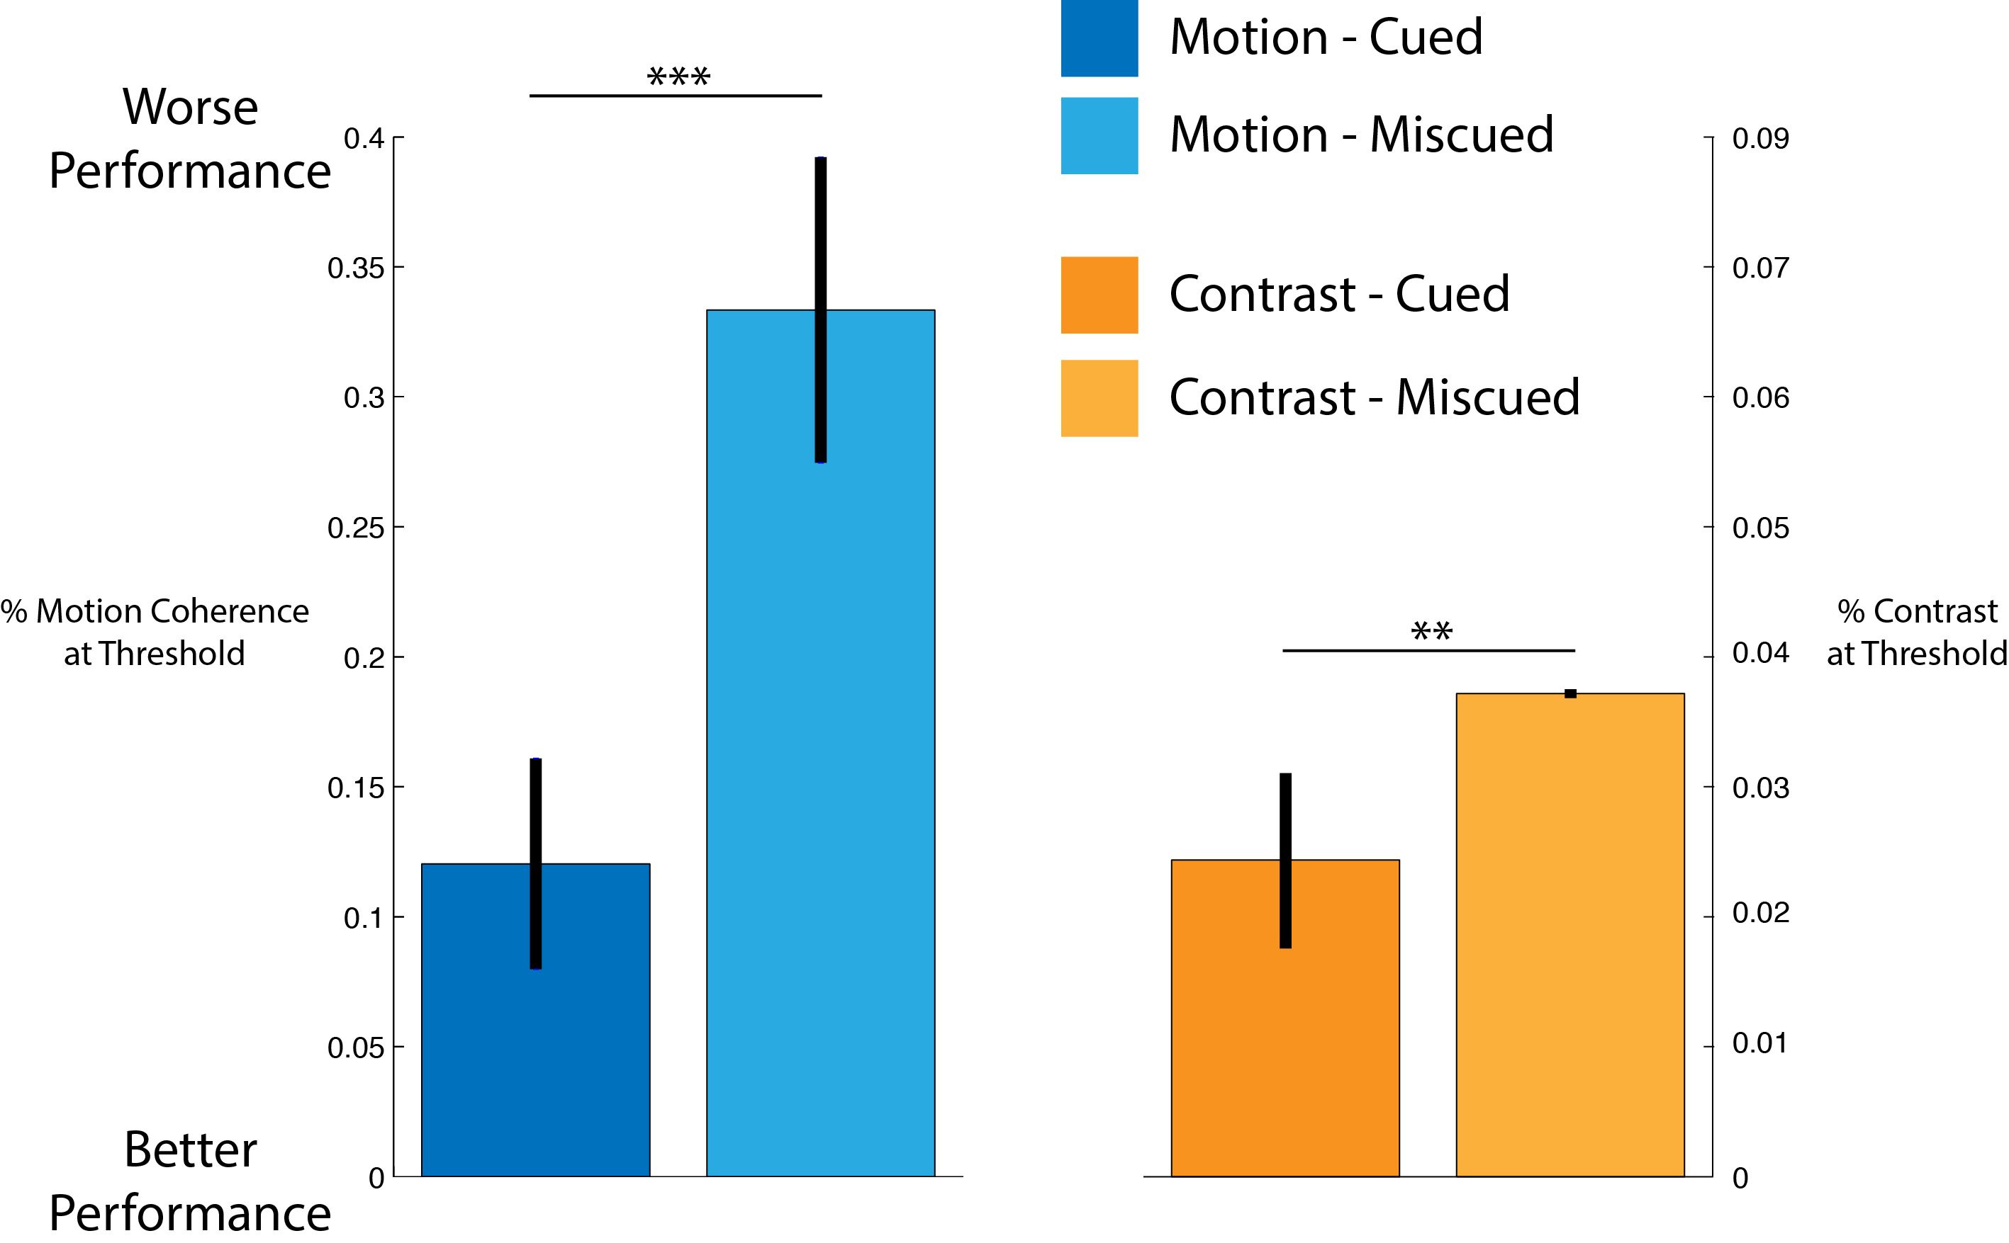

Slide 15
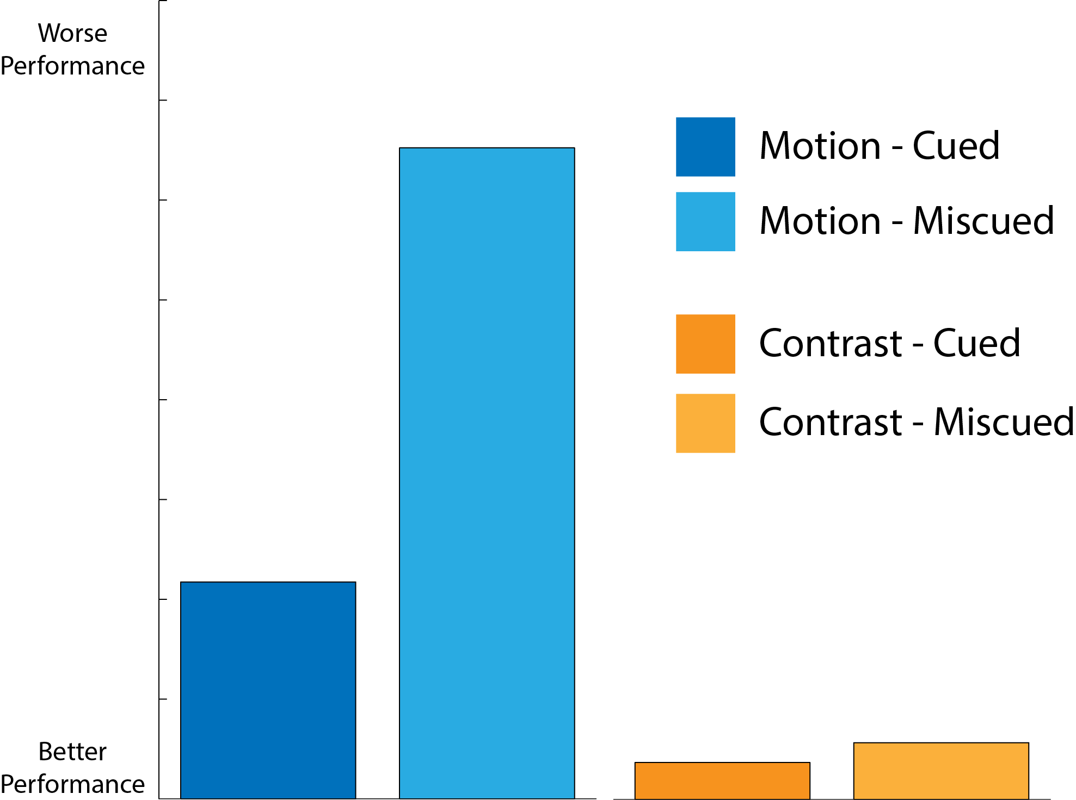
Stimulus Strength
Stimulus Strength

Slide 16
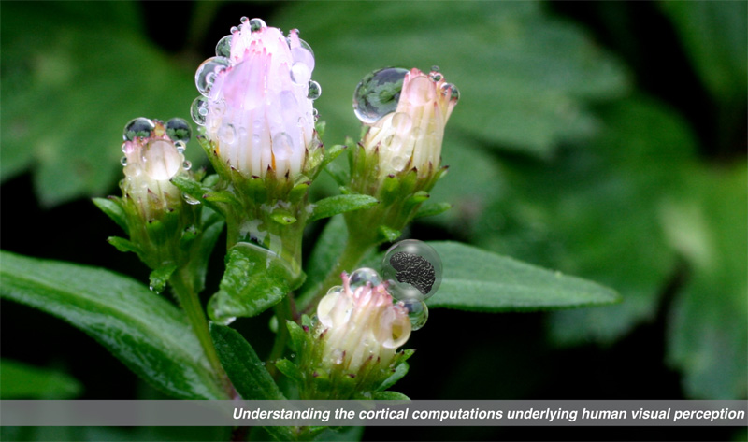

Gardner Lab @ Stanford University
Justin Gardner

